Slide 1

SHARK ATTACKS
A data ANALYTICS PROJECT

Slide 2
INTRODUCTION
Based on a data file, we have proceeded to clean and standardize the data in order to draw conclusions.
The file contains records of shark attacks, and indicates place, time, injuries... and also who has been attacked according to gender.

Slide 3
DATA CLEANING
Extraction of year, month and day based on CASE NUMBER.
Cleaning of null elements
Standardize the activities.
Unified countries.
AGE, SEX and FATAL fields have been filtered and cleaned. These fields are necessary for the corresponding analysis.

Slide 4
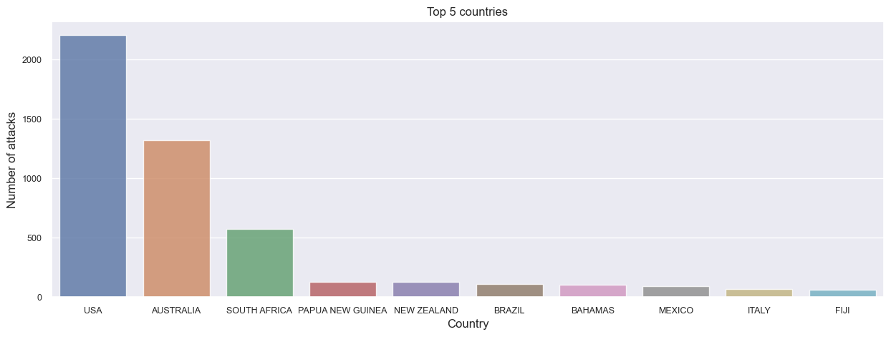
HYPOTHESIS
Locate in which country most of the shark attacks take place.
The majority of attacks are located in the USA and Australia. This would be expected given the size of the coastline of both countries, as well as the ecosystem that is located in these countries.

Slide 5
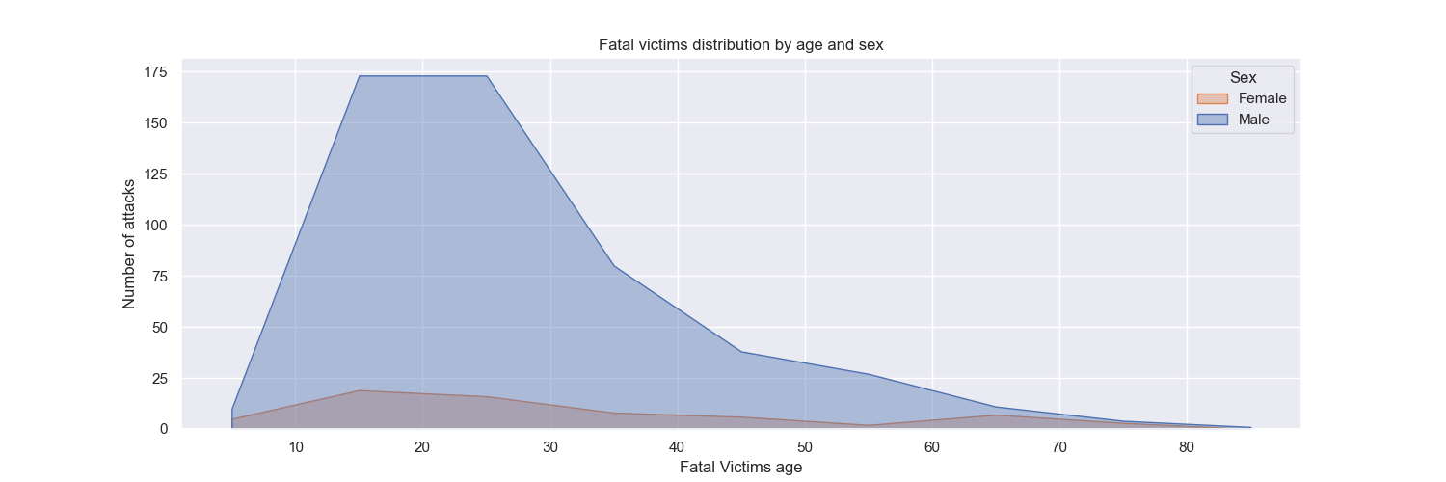
HYPOTHESIS
To know which gender/age is mainly attacked
The number of male victims is clearly higher than that of female victims.
The most targeted age range is rather young (around 15-25 years old)

Slide 6
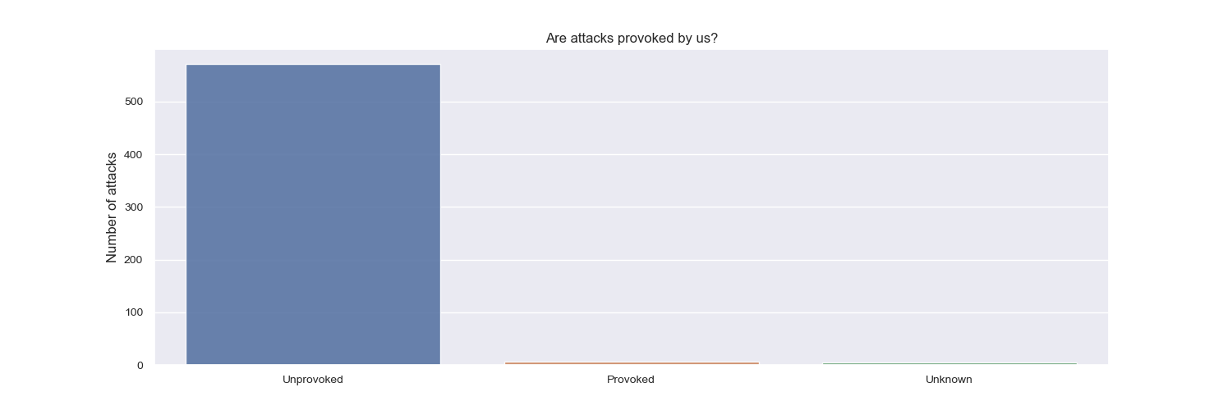
HYPOTHESIS
To know which gender and age is mainly attacked
81% of attacks are unprovoked by the victims, so it is deduced that the shark defends itself in case of confusion or surprise

Slide 7
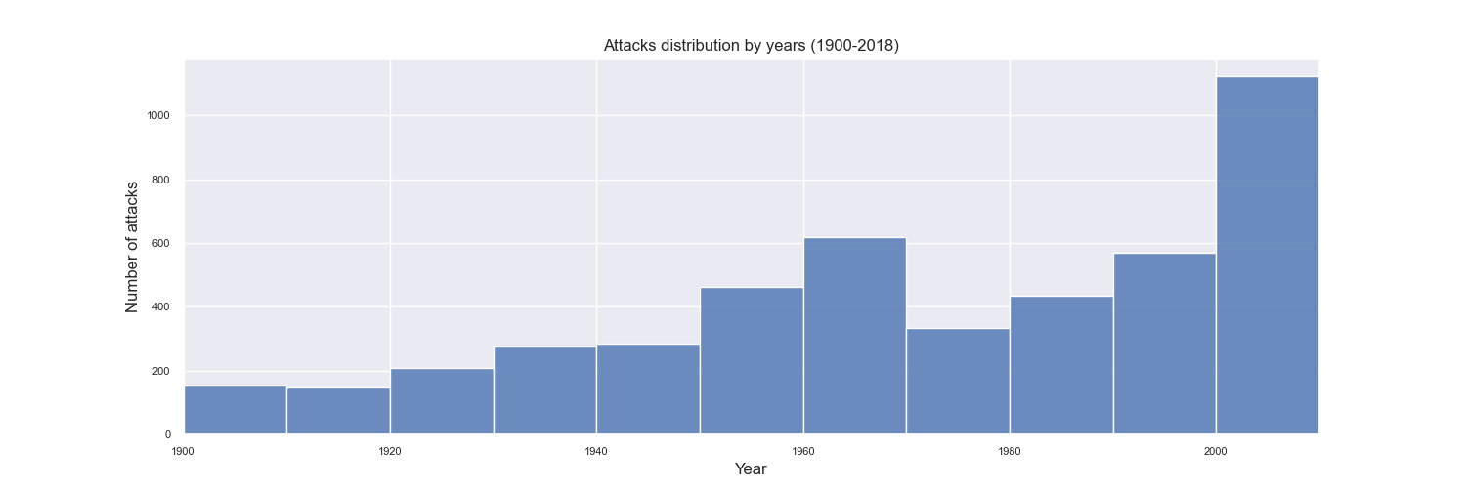
HYPOTHESIS
To analyze the attacks from 1900 to 2018.
We see an evolution in the number of attacks, but we must take into account that we must evaluate the number of records.
Clear increase in the 2000s.

Slide 8
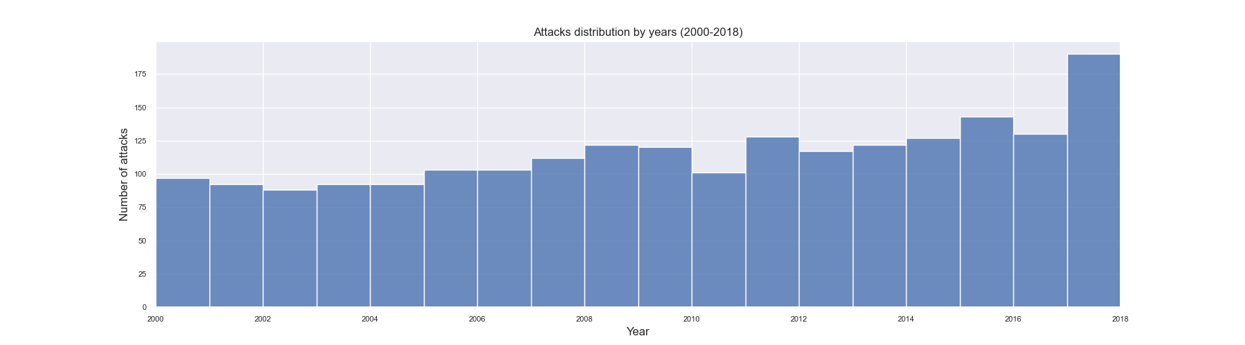
HYPOTHESIS
High increase since 2000
Since the year 2000 there has been a considerable increase in the number of attacks recorded (higher number of follow-ups or more attacks?

Slide 9
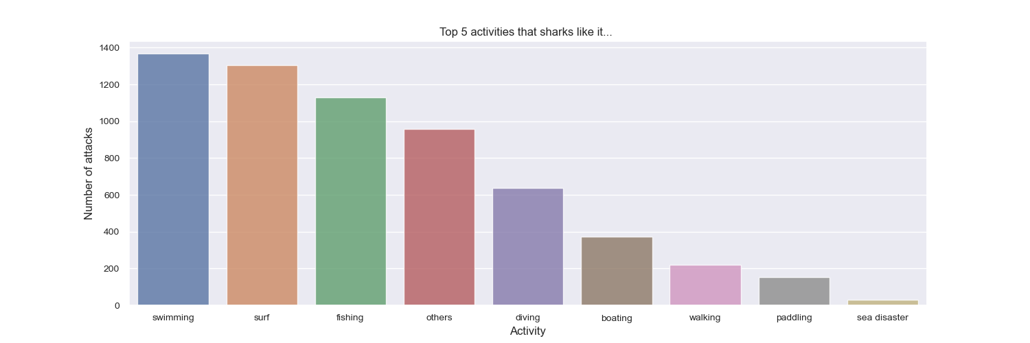
HYPOTHESIS
To analyze the activities in which the most attacks tend to occur
The activities practiced by the victims are swimming or bathing, and surfing sports. The sports practices may be related to the age of the victims.

Slide 10
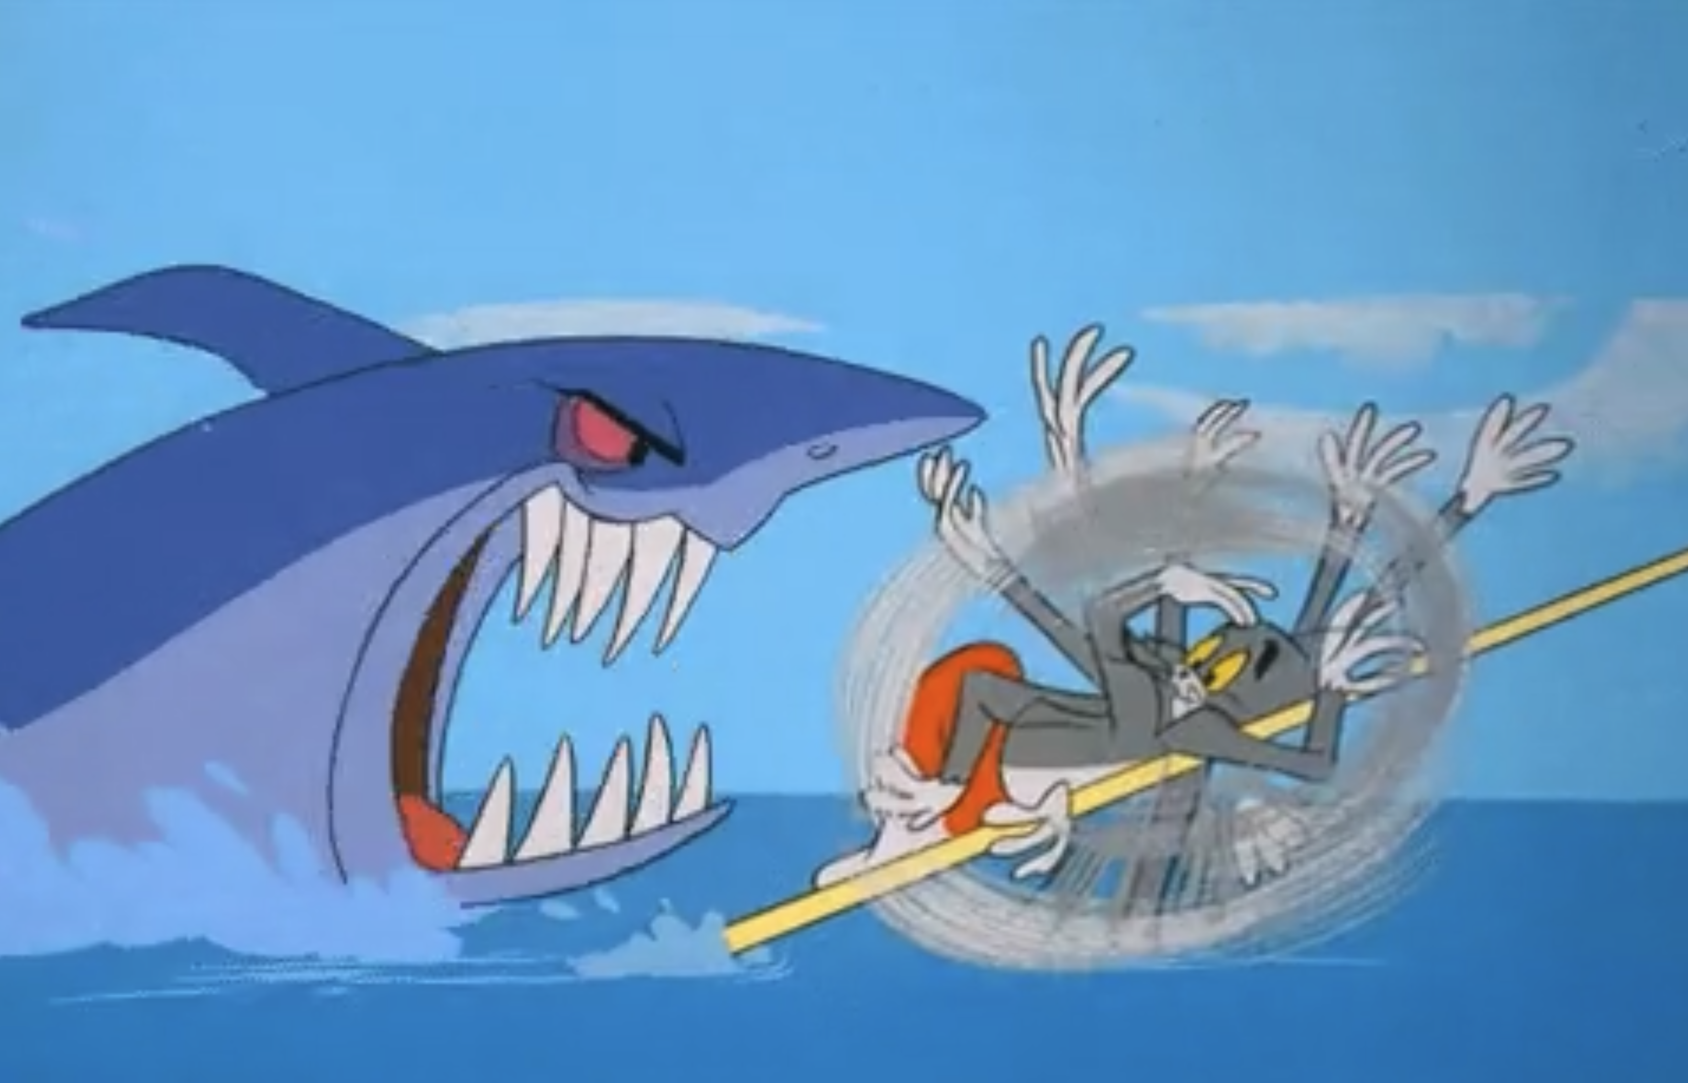
THANKS!

